Slide 1

Cybersecurity In Smart Grid
Presenting Under The Guidance Of Prof. Tricia Chigan
University Of Massachusetts – Lowell
Dept. Of Electrical And Computer Engineering

Slide 2
Overview
Traditional Power Grid & Smart Grid
Security of Smart Grid
Components of Smart grid
Types of attack
AMI ( Advanced Metering Infrastructure)
Working and Components of AMI
Types of attacks and counter measure
Algorithms
SCADA (Supervisory control and data acquisition )
SCADA Protocol
Vulnerability and Attacks
Solutions
Summary

Slide 3
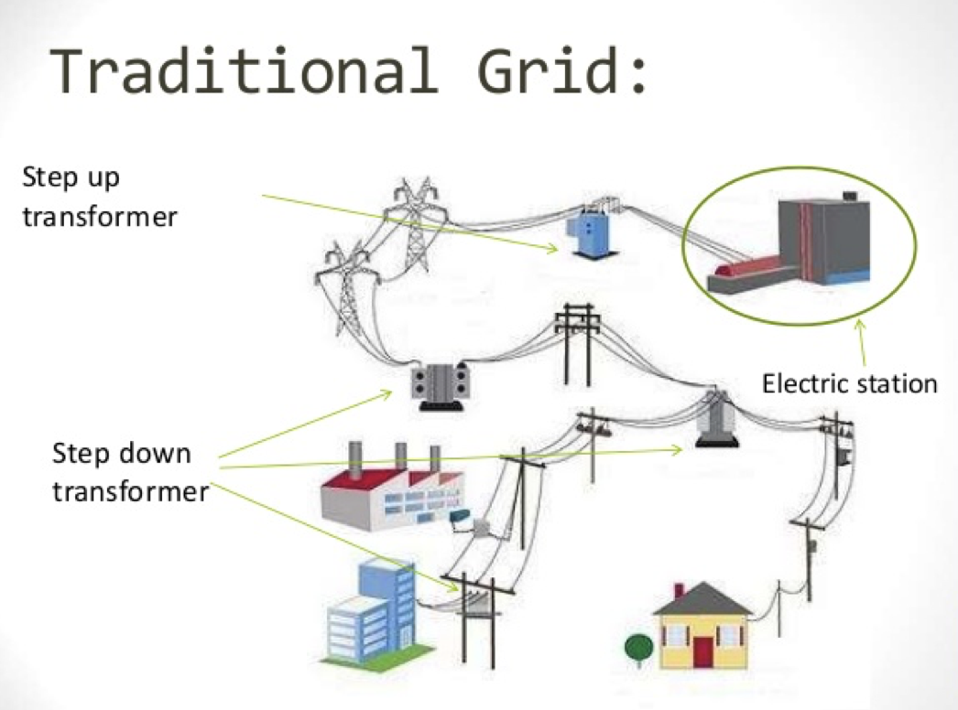
BACKGROUND
Notes:
FLAWS
Aging power equipment's :
Obsolete system layout
Outdated engineering
Old cultural value
Difficult maintenance and extension procedure

Slide 4
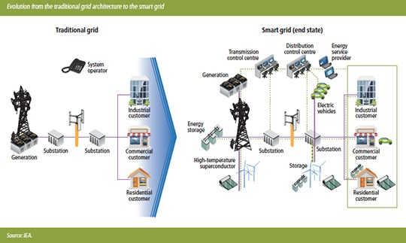
SMART GRID

Slide 5
COMPARISION
Traditional power grid
Smart grid
Centralized power generation
One – directional power flow
Generation follows load
Operational based on historical experience
Limited grid access to new consumers
Few sensors
Failures and blackouts
Centralized/distributed power generation
Multi-directional power flow
Load follows generation
Operation based on real time data
Full and efficient grid accessibility
Sensors placed throughout
Consumer participates in the market
Intermittent renewable power generation

Slide 6
About Smart Grid
Smart Grid Attributes
Information-based
Communicating
Secure
Self-healing
Reliable
Flexible
Cost-effective
Dynamically controllable

Slide 7
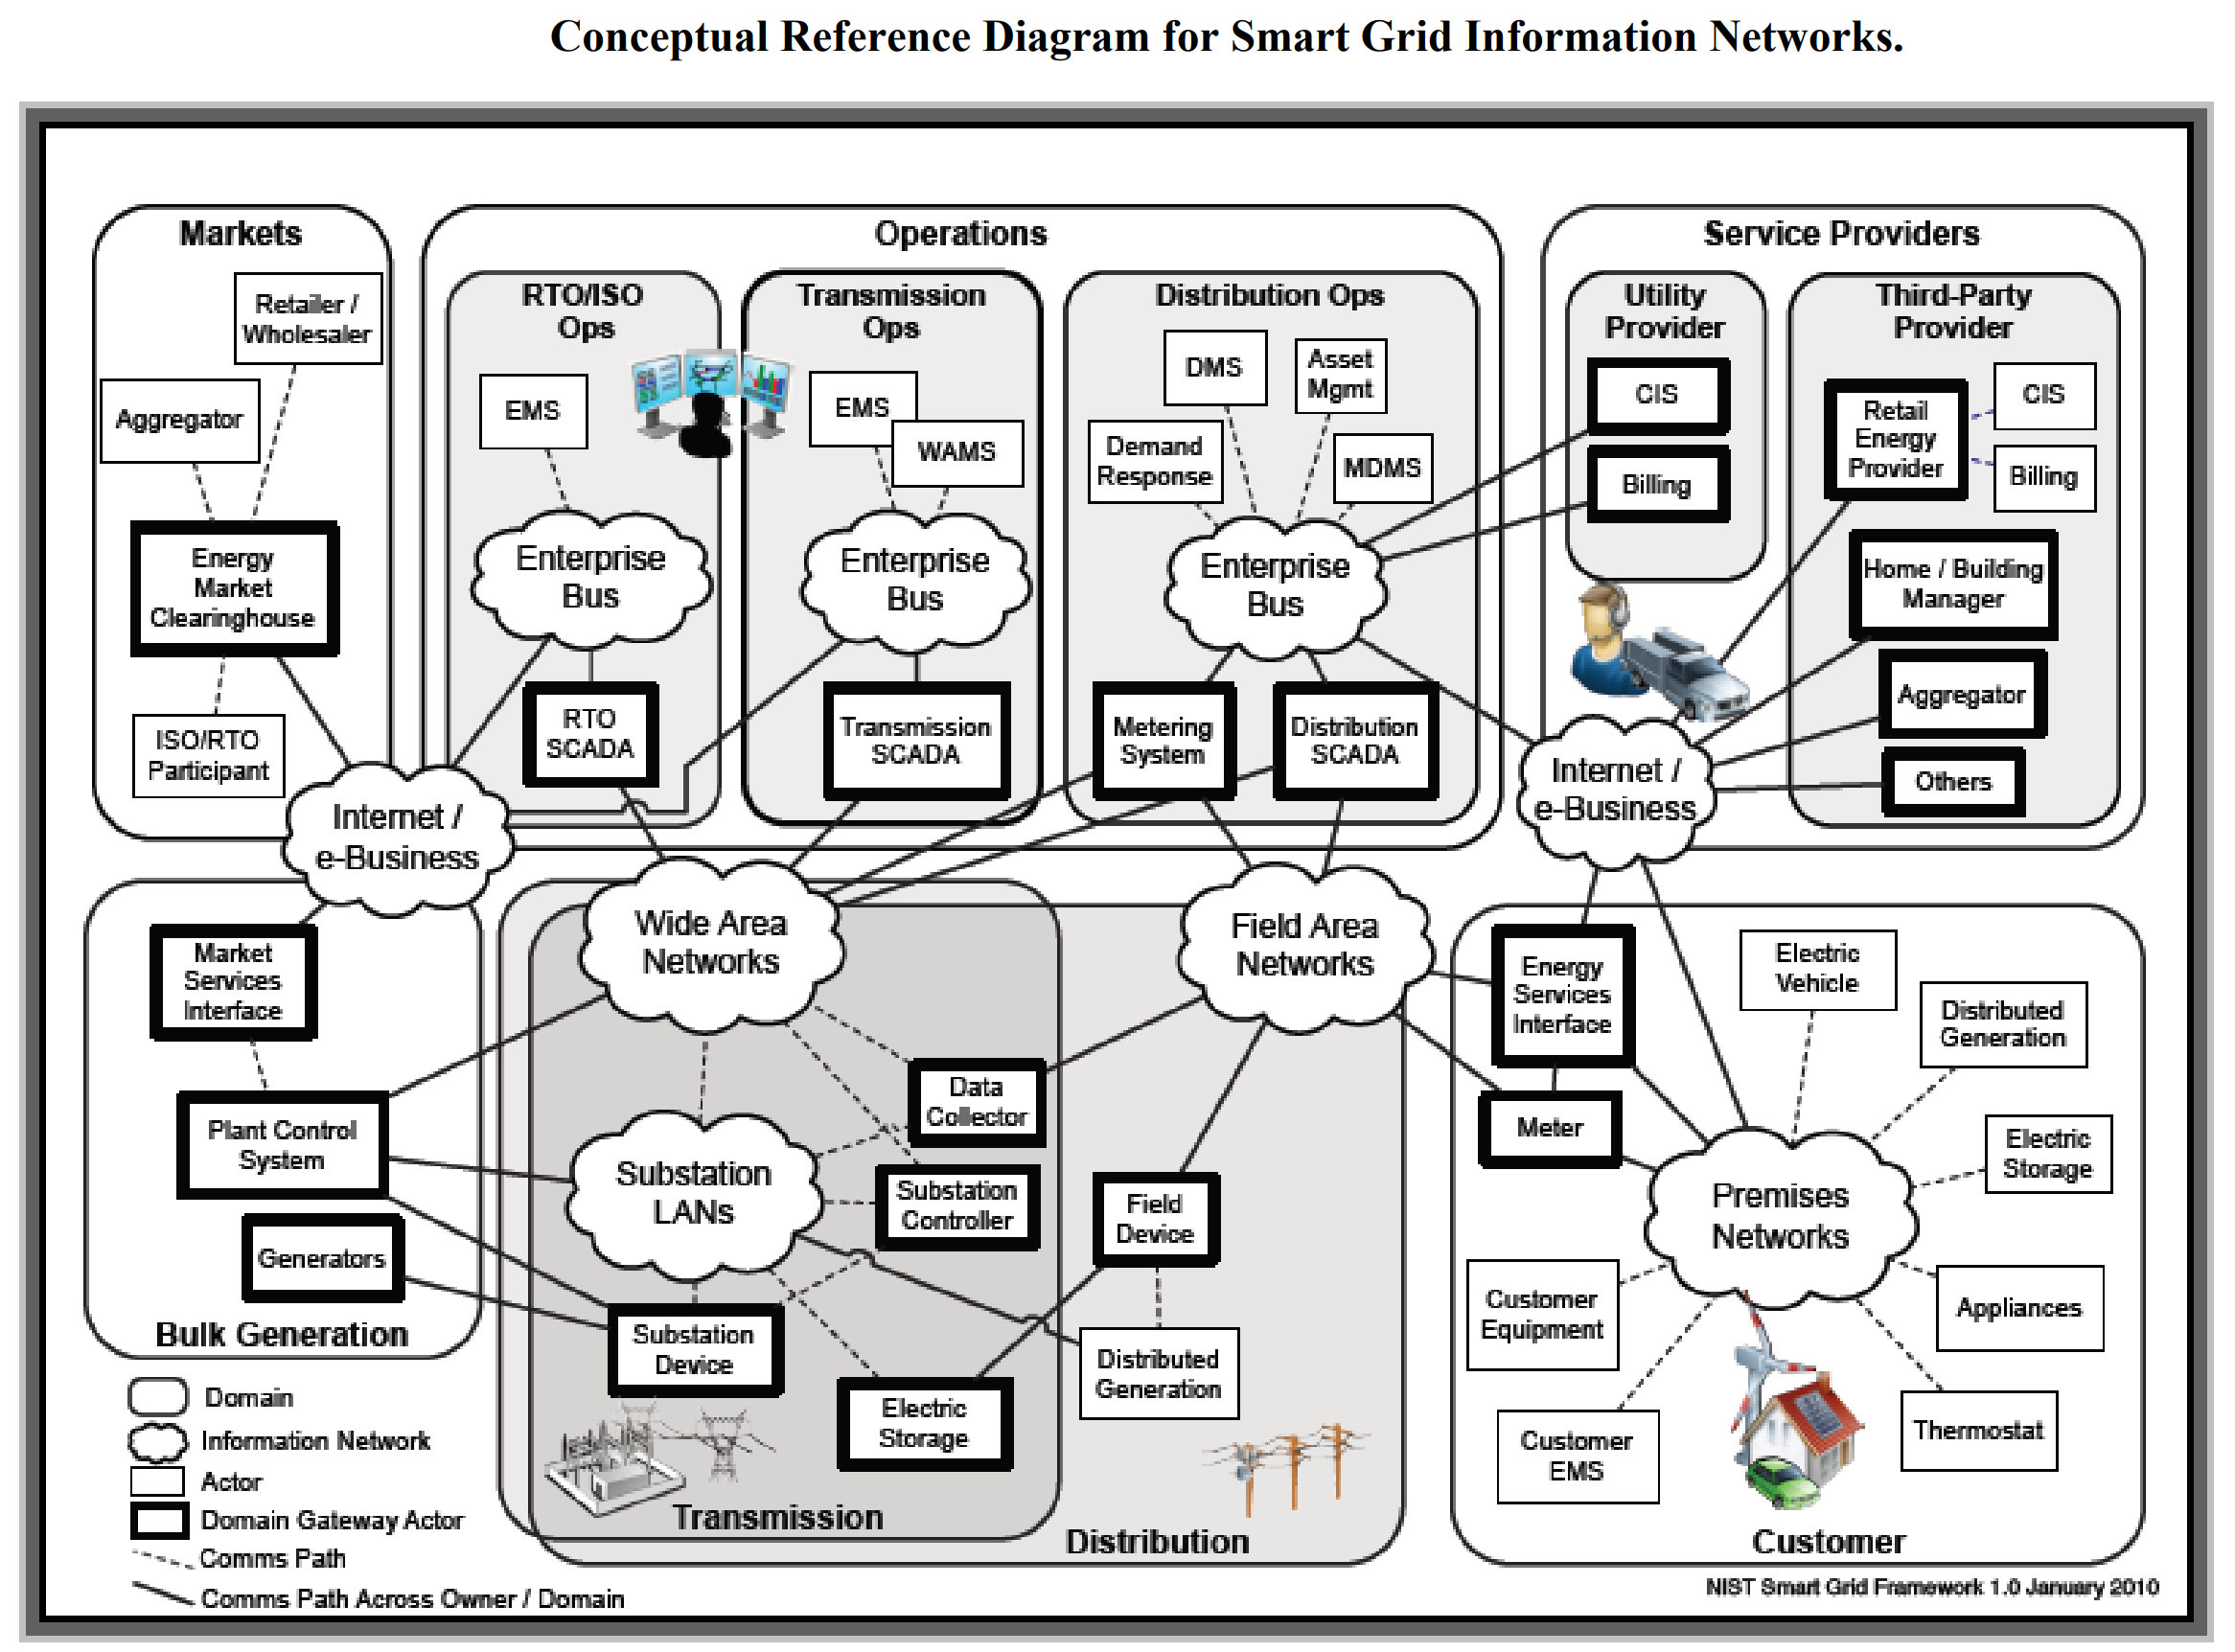

Slide 8
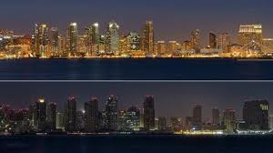
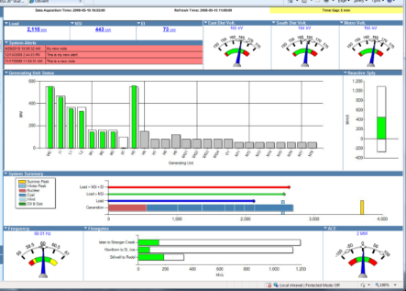
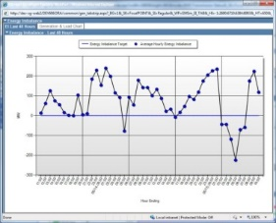
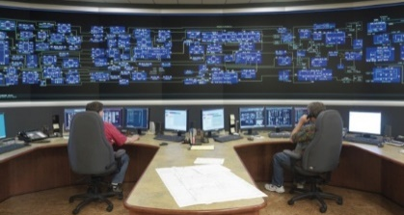
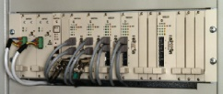

Why is Cyber Security an issue? Threats & Vulnerabilities
Operation Sabotages
Data Security
(Database & Communication)
Communication
Interference
Grid Security

Slide 9
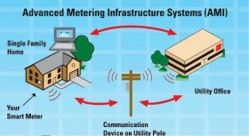
Advanced metering infrastructure
Systems that measure, collect and analyze energy usage, and communicate with metering devices
such as electricity meters, gas meters, heat meters, and water meters, either on request or on a schedule
Two-way communication between utility and meters
Basis of Smart Grid... AMI is the base network

Slide 10
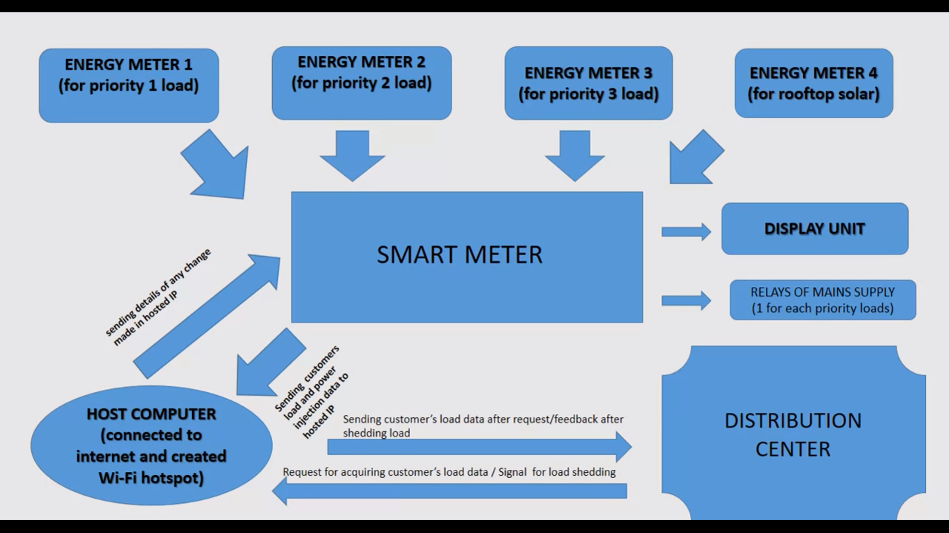
AMI Working

Slide 11
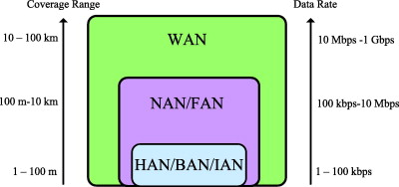
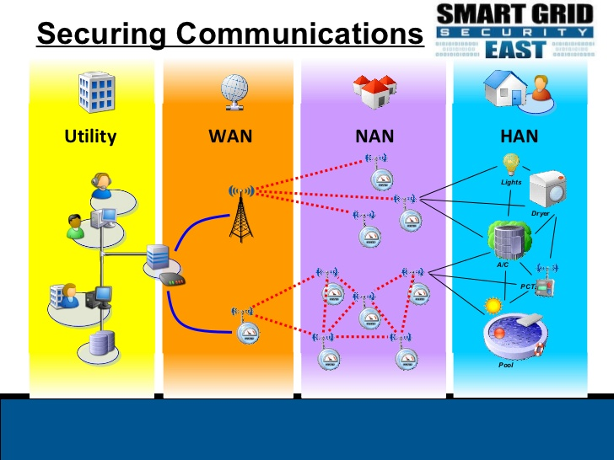
AMI DIVISIONS
Notes:
https://www.sciencedirect.com/science/article/pii/S1389128614001431#f0010

Slide 12
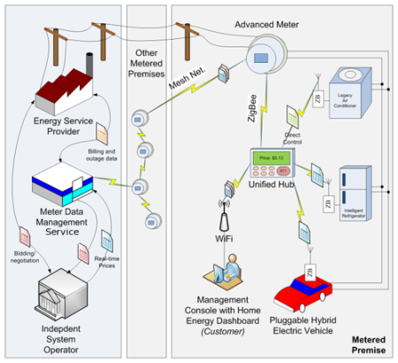
Advanced metering infrastructure
Notes:
Zig bee is used in application layer
Advanced encryption standard is used in network layer
Zigbee provides end to end to security with out encryption and decryption at every hop.

Slide 13
Advantages Of AMI
Managing Supply and Demand
Distribution Network Management
Variable Pricing Structures
Improved Data Quality
Reduced Load In Call Centers
Customer Intelligence

Slide 14
Advanced metering infrastructure
Vulnerabilities
Solutions
Plaintext NAN Traffic
Direct Tempering
Cryptographic Key Distribution
Network Time Services
Improper Cryptography
Weak Key Derivation
Lack of Replay Protection
Insecure Cipher Modes
Weak Integrity Protection
Mandatory algorithms
Using of Optical fibers
Third party key distribution
Nodes have sync clock
Using better algorithms
AES Algorithm
Humming bird algorithm

Slide 15
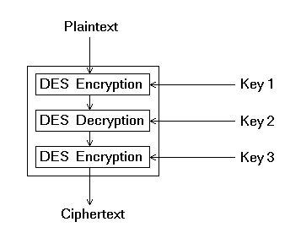
Encryption Algorithms
Triple DES Algorithm (TDES / TDEA)
Original DES algorithm Key size = 56 Bits.
Insufficient as brute force attacks increased.
TDEA : Algorithm remains same, key size increased.
Three keys : K_{1,} K₂, K₃ ; Each 56 bits
Encryption :
Cipher-Text = E_{K3}(D_{K2}(E_{K1}(Plain-Text)))
Decryption :
Plain-Text = D_{K1}(E_{K2}(D_{K3}(Cipher-Text)))

Slide 16
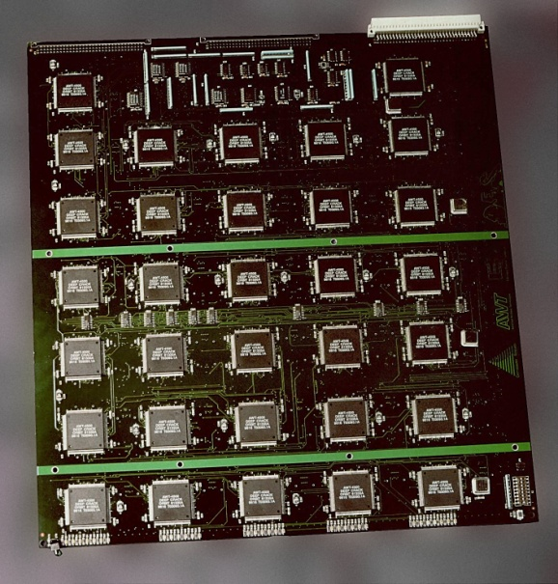
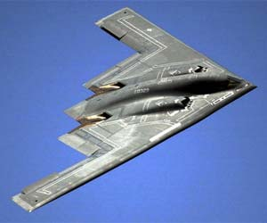
Triple DES Algorithm - Attacks
Linear Cryptanalysis : Linear approximation can reduce number of data
required to break the code by a factor of 4 !
Improved Davies’ Attack : Specialized technique to attack DES and TDEA.
Hit rate : 50 %
USD 929 million per aircraft

Slide 17
Advanced Encryption Algorithm (AES Algorithm)
Supersedes DES / TDEA
Fixed block size of 128 bits with key size of 128, 192 and 256 Bits
Key Expansion
Initial Round
Encrypting Rounds
Sub Bytes
Shift Rows
Mix Columns
Final Round
Sub Bytes
Shift Rows
Add Round Key

Slide 18
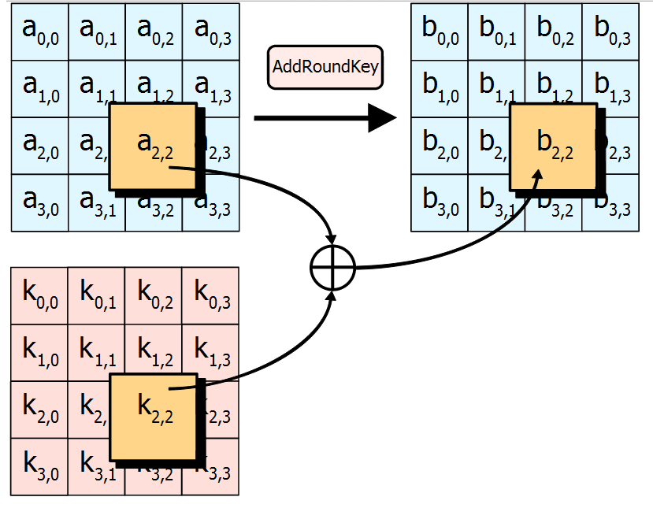
Advanced Encryption Algorithm Initial Round
Source : http://csrc.nist.gov

Slide 19
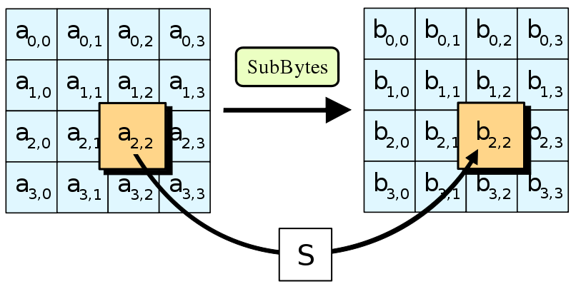
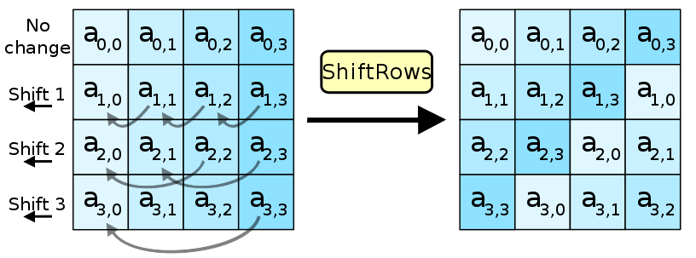
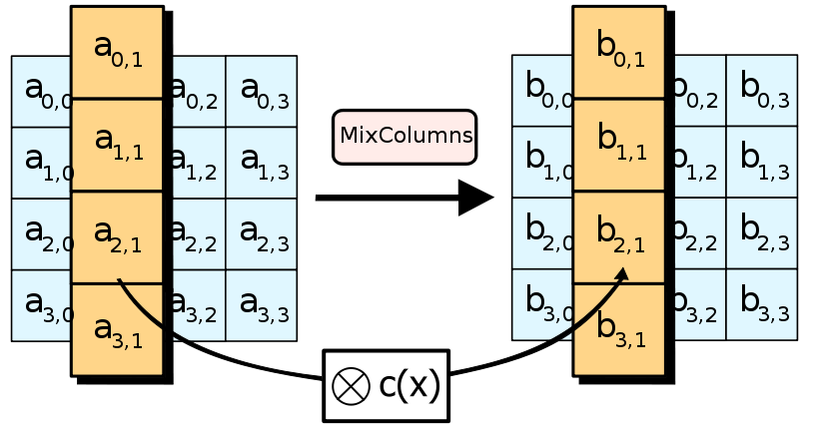
Advanced Encryption Algorithm Encrypting and Final Rounds
(i) Sub Bytes Round
(iii) Mix Columns
(ii) Shift Rows
Source : http://csrc.nist.gov

Slide 20
Advanced Encryption Algorithm - Attacks
Requires Very high computation power and slow
Brute force
New class of attacks called XSL, described by Nicolas Courtois and Josef Pieprzyk; still under heavy academic consideration.
XSL : Extended Sparse Linearization
While XSL is much faster than Brute Force, the resources used is very high. Practically difficult to implement.

Slide 21
Hummingbird -1 (HB-1 Algorithm)
Lightweight
256 Encryption key
Presently used in the Smart Grid market
Initialization
Permutation
Encryption Function

Slide 22
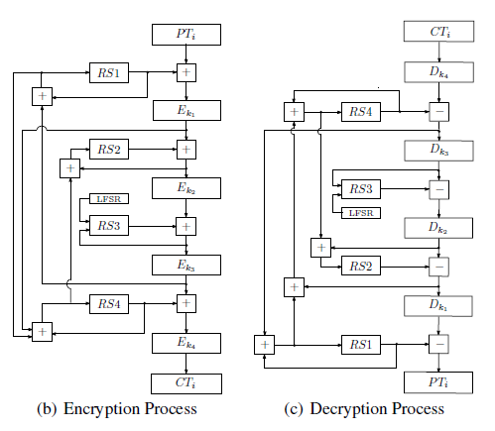
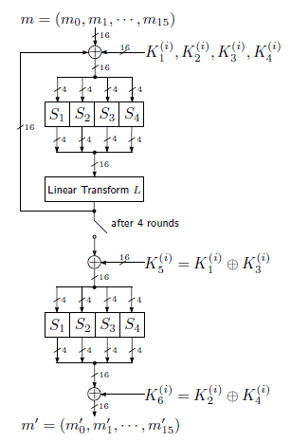
Hummingbird -1 – Rounds Top Level
Notes:
Source : Xinxin Fin et al, ‘Design Space Exploration of Hummingbird Implementations on FPGS.’

Slide 23
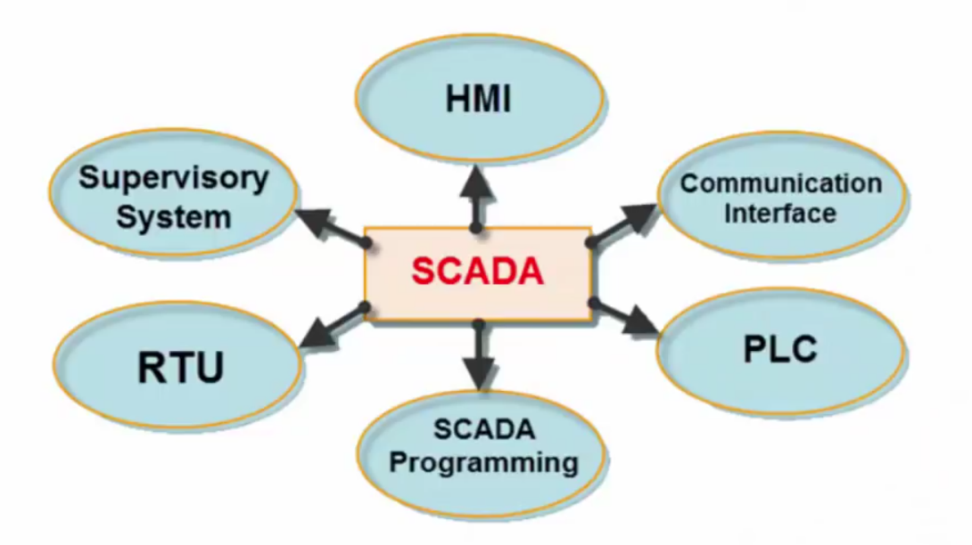
SCADA ( Supervisory Control and Data Acquisition)
The main goal of SCADA
Helping the grid reduce operation and maintenance costs and ensure the reliability of the power supply.
Notes:
Early SCADA systems were independent, with no connectivity to other systems
Second generation SCADA systems were distributed, using local networks or leased lines
Third generation of SCADA systems are wide-area networked over the public Internet using industry standard protocols and security techniques
Being on the Internet, they are potentially vulnerable to attack but by using standard protocols, then industry-wide security measures can be taken to protect the systems
23

Slide 24
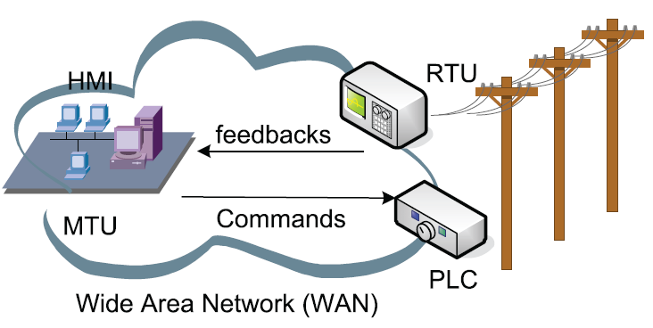
A typical SCADA architecture
MTU: Master Terminal Unit HMI: Human Machine Interface
RTU: Remote Terminal Unit PLC: Programmable Logic Controller
Field data interface devices: Including RTU and PLC
Notes:
24

Slide 25
SCADA’s Protocol
Distributed Network Protocol Version (DNP3)
Communications between master stations, remote Terminal units (RTUs) & intelligent electronic devices (IEDs).
Designed specifically for SCADA. There was one before this one called Modbus.
DNP3 is an open protocol standard.

Slide 26
SCADA vulnerability points
Unused telephone line – war dialing
Use of removable media – stuxnet
Infected Bluetooth enabled devices
Wi-Fi enabled computer that has Ethernet connection to SCADA system
Insufficiently secure Wi-Fi
Corporate LAN /WAN
Corporate web server email servers internet gateways
Notes:
It must not be outrageously expensive in terms of the performance of the system to include security
Still threat probability should be reduced to near zero value
Physical and operational security also has to be given some level of importance

Slide 27
Various attacks on SCADA
Over the past few years, an alarming number of cyber attacks, viruses and data breaches have targeted critical infrastructure SCADA systems.
Like: Web servers or SQL attacks, Email attacks, Zombie recruitment, DDOS attacks
Examples
Stuxnet - Worm (Reportedly 1/5th of Iran’s nuclear centrifuges were ruined) Scary Part: Stuxnet’s design and architecture are not domain-specific and it could be tailored as a platform for attacking modern SCADA and PLC.
Flame - Worm (Attacks computers running the Windows , Used for targeted cyber espionage in Middle Eastern countries) Scary Part: via USB stick Can record audio, screenshots, keyboard activity and network traffic, also records Skype conversations
Notes:
Reference: The Rise of Critical Infrastructure Attacks: Understanding the Privileged Connection and Common Thread
Yariv Lenchner | Aug 16, 2013, intelligentutility
http://www.intelligentutility.com/article/13/08/rise-critical-infrastructure-attacks-understanding-privileged-connection-and-common-thread
SCADA Security Issues
Distribution control commands and access logs are critical for SCADA systems. Intercepting, tampering, or forging these data damages the grid.
Possible solutions: Ensure all commands and log files are accurate and secure.
Synchronizing time-tagged data in wide areas is essential; without it the safety and reliability of the SCADA system cannot be achieved.
Possible solutions: Use a common time reference for time synchronization.
Every decision of SCADA comes from the analysis of the raw data based on a reasonable model. Improper models may mislead operator actions. In addition, different vendors using distinct SCADA models will disrupt the consistency of the grid.
Possible solutions: So far, no.
Other security issues ?
Stuxnet
A computer worm that was detected in June 2010, but allegedly has been around since 2007
Was designed to attack industria PLCs of nuclear SCADA systems
Compromised Iranian PLCs at Iran’s Natanz uranium enrichment facility, changing the speeds of the fast-spinning centrifuges, at the same time hiding the damage
Reportedly 1/5th of Iran’s nuclear centrifuges were ruined
60% of Stuxnet infected systems were in Iran
But the attackers took great care to avoid catastrophic damage, not to blow cover – attack sequence executed approximately once a month
Scary Part: Stuxnet’s design and architecture are not domain-specific and it could be tailored as a platform for attacking modern SCADA and PLC
Source code publicly available
http://www.laboratoryb.org/stuxnet-source-code-on-github/
Functions by targeting machines using Windows, then seeking out Siemens S7-300 systems
Has three modules:
a worm that executes all routines related to the main payload of the attack;
a link file that automatically executes the propagated copies of the worm;
and a rootkit component responsible for hiding all malicious files and processes, preventing detection of the presence of Stuxnet
Introduced to the target environment by infected USB flash drive, system does not need to be connected to the Internet!
Propagates across the network, scanning for Siemens Step7 software on PLCs
Introduces infected rootkit onto the PLC and Step7 software, modifying the codes and giving unexpected commands to the PLC
Flame Malware
Detected in 2012
Attacks computers running the Windows
Used for targeted cyber espionage in Middle Eastern countries
Spread to other systems over a LAN or via USB stick
Can record audio, screenshots, keyboard activity and network traffic, also records Skype conversations
Shamoon Malware
Also detected in 2012
Similar to Flame - attacks computers running the Windows
Capable of spreading to other computers on the network, through exploitation of shared hard drives
Once a system is infected, the virus continues to erase files from a file system
Finally, the virus will overwrite the master boot record of the system to prevent it from booting
The virus has hit companies within the oil and energy sectors
On August 15, 2012, a group named "Cutting Sword of Justice" claimed responsibility for an attack on 30,000 workstations of Saudi Aramco, an oil company
Red Octomber
Detected in January 2013
A sophisticated Remote Access Trojan (RAT) infrastructure utilizing a chain of > 60 command-and-control servers
Silently gathering data from computers, smartphones, and external storage like USB sticks from high-profile targets around the world since 2007
Most of the targets in Eastern Europe and Central Asia, but more than 60 countries have been hit
First infiltrates computers using email attachments such as Word and Excel files
Data is beamed back to a command server, which assigns each victim a 20-hex digit code to identify it
This foothold, more alarmingly, can spread to mobile devices
Operation Red October: The top-secret global espionage campaign that's been running for five years
By Chris Gayomali | January 15, 2013, The Week
http://theweek.com/article/index/238764/operation-red-october-the-top-secret-global-espionage-campaign-thats-been-running-for-five-years
Dragonfly
Symantec linked Havex to a loose association of attackers that energy suppliers call Dragonfly
News reports in Europe said Dragonfly, backed by groups in Russia, could have hacked computer systems at more than 1,000 organizations in at least 84 countries in the past 18 months
Majority of the victims have been in the US, Spain, France, Italy, Germany, Turkey and Poland
Targets include energy grid, major electricity generation firms, petroleum pipeline operators and energy industrial equipment providers
Dragonfly uses attack methods such as
extracting and uploading stolen data,
installing further malware onto systems,
and running executable files on infected computers.

Slide 28
Various attacks on SCADA (Con’t)
Examples
Shamoon (Similar to Flame - attacks computers running the Windows ) Scary Part: : Once a system is infected, the virus continues to erase files from a file system Finally, the virus will overwrite the master boot record of the system to prevent it from booting
Red October
DragonFly
Notes:
Reference: The Rise of Critical Infrastructure Attacks: Understanding the Privileged Connection and Common Thread
Yariv Lenchner | Aug 16, 2013, intelligentutility
http://www.intelligentutility.com/article/13/08/rise-critical-infrastructure-attacks-understanding-privileged-connection-and-common-thread
SCADA Security Issues
Distribution control commands and access logs are critical for SCADA systems. Intercepting, tampering, or forging these data damages the grid.
Possible solutions: Ensure all commands and log files are accurate and secure.
Synchronizing time-tagged data in wide areas is essential; without it the safety and reliability of the SCADA system cannot be achieved.
Possible solutions: Use a common time reference for time synchronization.
Every decision of SCADA comes from the analysis of the raw data based on a reasonable model. Improper models may mislead operator actions. In addition, different vendors using distinct SCADA models will disrupt the consistency of the grid.
Possible solutions: So far, no.
Other security issues ?
Stuxnet
A computer worm that was detected in June 2010, but allegedly has been around since 2007
Was designed to attack industria PLCs of nuclear SCADA systems
Compromised Iranian PLCs at Iran’s Natanz uranium enrichment facility, changing the speeds of the fast-spinning centrifuges, at the same time hiding the damage
Reportedly 1/5th of Iran’s nuclear centrifuges were ruined
60% of Stuxnet infected systems were in Iran
But the attackers took great care to avoid catastrophic damage, not to blow cover – attack sequence executed approximately once a month
Scary Part: Stuxnet’s design and architecture are not domain-specific and it could be tailored as a platform for attacking modern SCADA and PLC
Source code publicly available
http://www.laboratoryb.org/stuxnet-source-code-on-github/
Functions by targeting machines using Windows, then seeking out Siemens S7-300 systems
Has three modules:
a worm that executes all routines related to the main payload of the attack;
a link file that automatically executes the propagated copies of the worm;
and a rootkit component responsible for hiding all malicious files and processes, preventing detection of the presence of Stuxnet
Introduced to the target environment by infected USB flash drive, system does not need to be connected to the Internet!
Propagates across the network, scanning for Siemens Step7 software on PLCs
Introduces infected rootkit onto the PLC and Step7 software, modifying the codes and giving unexpected commands to the PLC
Flame Malware
Detected in 2012
Attacks computers running the Windows
Used for targeted cyber espionage in Middle Eastern countries
Spread to other systems over a LAN or via USB stick
Can record audio, screenshots, keyboard activity and network traffic, also records Skype conversations
Shamoon Malware
Also detected in 2012
Similar to Flame - attacks computers running the Windows
Capable of spreading to other computers on the network, through exploitation of shared hard drives
Once a system is infected, the virus continues to erase files from a file system
Finally, the virus will overwrite the master boot record of the system to prevent it from booting
The virus has hit companies within the oil and energy sectors
On August 15, 2012, a group named "Cutting Sword of Justice" claimed responsibility for an attack on 30,000 workstations of Saudi Aramco, an oil company
Red Octomber
Detected in January 2013
A sophisticated Remote Access Trojan (RAT) infrastructure utilizing a chain of > 60 command-and-control servers
Silently gathering data from computers, smartphones, and external storage like USB sticks from high-profile targets around the world since 2007
Most of the targets in Eastern Europe and Central Asia, but more than 60 countries have been hit
First infiltrates computers using email attachments such as Word and Excel files
Data is beamed back to a command server, which assigns each victim a 20-hex digit code to identify it
This foothold, more alarmingly, can spread to mobile devices
Operation Red October: The top-secret global espionage campaign that's been running for five years
By Chris Gayomali | January 15, 2013, The Week
http://theweek.com/article/index/238764/operation-red-october-the-top-secret-global-espionage-campaign-thats-been-running-for-five-years
Dragonfly
Symantec linked Havex to a loose association of attackers that energy suppliers call Dragonfly
News reports in Europe said Dragonfly, backed by groups in Russia, could have hacked computer systems at more than 1,000 organizations in at least 84 countries in the past 18 months
Majority of the victims have been in the US, Spain, France, Italy, Germany, Turkey and Poland
Targets include energy grid, major electricity generation firms, petroleum pipeline operators and energy industrial equipment providers
Dragonfly uses attack methods such as
extracting and uploading stolen data,
installing further malware onto systems,
and running executable files on infected computers.

Slide 29
SCADA attacks
Internal attacks
Employee
Contractor
External attacks
Non specific- malware , hackers
Targeted
Special knowledge – former insider
No special knowledge –hacker terrorist
Natural disaster
Manmade disasters
Notes:
P240 cyber security of scada
In order to neutralise these kinds of attacks we have to analyse the different vulnerabilities and anticipate different attacks possible
Based on a study scada (which forms the heart of automation ) attacks can be classified into

Slide 30
Protocol based attacks
All protocols runs on top of IP protocol and IP protocol has its own set of weakness.
The protocol is vulnerable to out-of-order, unexpected or incorrectly formatted packets.
A significant weakness for IEC 61850 is that it maps to MMS (Manufacturing message specification)as the communications platform, which itself has a wide range of potential vulnerabilities.

Slide 31
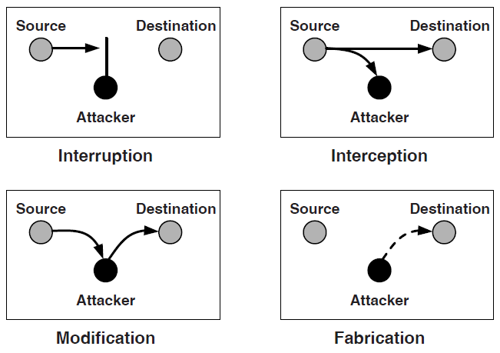
Attacks on the DNP3 Protocol
DNP3 attack taxonomy
Notes:
(Source: C. Palmer and S. Shenoi, 2009)

Slide 32
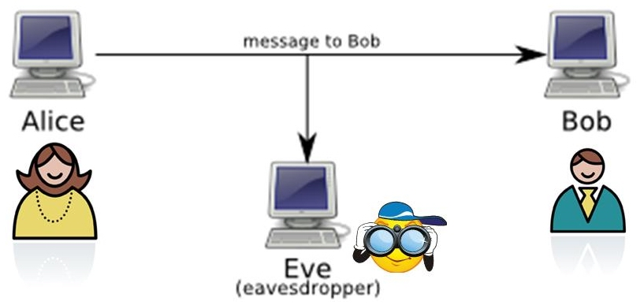
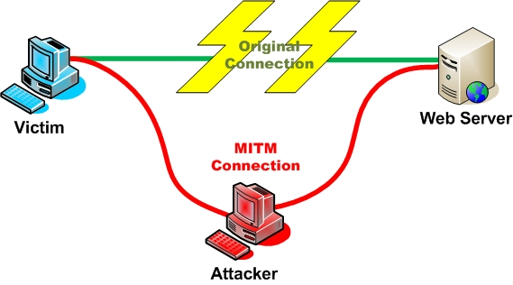
Attacks on the DNP3 Protocol (Con’t)
Common Attacks (Similar to Internet)
Passive Network Analysis: An attacker captures and analyzes DNP3 messages.
Man-in-the-middle: An attacker is between both sides.

Slide 33
Attacks on the DNP3 Protocol (Con’t)
Data Link Layer Attacks
Length Overflow Attack
DFC Flag Attack
Reset Function Attack
Unavailable Function Attack
Destination Address Alteration

Slide 34
Attacks on the DNP3 Protocol (Con’t)
Pseudo-Transport Layer Attacks
Fragmented Message Interruption:.
Transport Sequence Modification:
FIR
M1
M2
FIN
FIR
M1
FIN
M2
FIN

Slide 35




Attacks on the DNP3 Protocol (Con’t)
Application Layer Attacks
Outstation Write Attack
Clear Objects Attack
Outstation Data Reset
Outstation Application Termination

Slide 36
Attacks on the DNP3 Protocol (Con’t)
Application Layer Attacks (Con’t)
Configuration Capture Attack
2
Master
A new configuration file
A modified configuration file
Outstation A
3
1
Outstation A need
a new configuration file
Attacker

Slide 37
Solutions (so far)
Two possible ways to provide security for SCADA:
Encryption/decryption
Security enhancements placed directly in the protocol.
new security framework
Data structure of the DNP Data Link layer.

Slide 38
Summary
Smart Grid more expensive to setup, cheaper than traditional grid in the long run.
Various types of attacks and countermeasures.
Important components of Smart Grid i,e. SCADA, AMI.
DNP3 Protocol. And security measures.

Slide 39
References
https://www.nist.gov/engineering-laboratory/smart-grid
https://www.smartgrid.gov/the_smart_grid/smart_grid.html
http://www.ijsgce.com/uploadfile/2012/1011/20121011121836539.pdf
http://www.intelligentutility.com/article/13/08/rise-critical-infrastructure-attacks-understanding-privileged-connection-and-common-thread
http://fcw.com/articles/2014/07/02/dhs-warning-critical-infrastructure-attacks.aspx
http://www.networkworld.com/article/2223748/microsoft-subnet/critical-infrastructure-malware-infections--from-ics-cert-report-to-scada-strangelo.html
http://www.networkworld.com/article/2223748/microsoft-subnet/critical-infrastructure-malware-infections--from-ics-cert-report-to-scada-strangelo.html
http://theweek.com/article/index/238764/operation-red-october-the-top-secret-global-espionage-campaign-thats-been-running-for-five-years

Slide 40
References
http://theweek.com/article/index/238764/operation-red-october-the-top-secret-global-espionage-campaign-thats-been-running-for-five-years
http://en.wikipedia.org/wiki/Shamoon
http://en.wikipedia.org/wiki/Flame_(malware)
http://www.youtube.com/watch?v=6WmaZYJwJng

Slide 41
I’m Pleased to have Questions?

Slide 42
Thank You

